Slide 1
Naive Bayes Classifiers

Slide 2
Bayesian Classification:
A statistical classifier: performs probabilistic prediction, i.e., predicts class membership probabilities
Foundation: Based on Bayes’ Theorem.
Naive Bayes is a probabilistic machine learning algorithm that can be used in a wide variety of classification tasks.
Typical applications include filtering spam, classifying documents, sentiment prediction etc.

Slide 3
why is it called ‘Naive’?
The name naive is used because it assumes the features that go into the model is independent of each other.
That is changing the value of one feature, does not directly influence or change the value of any of the other features used in the algorithm.
It is a classification technique based on Bayes’ Theorem with an assumption of independence among predictors.
In simple terms, a Naive Bayes classifier assumes that the presence of a particular feature in a class is unrelated to the presence of any other feature.
For example, a fruit may be considered to be an apple if it is red, round, and about 3 inches in diameter. Even if these features depend on each other or upon the existence of the other features, all of these properties independently contribute to the probability that this fruit is an apple and that is why it is known as ‘Naive’.

Slide 4
Naive Bayes classifiers are a collection of classification algorithms based on Bayes’ Theorem.
It is not a single algorithm but a family of algorithms where all of them share a common principle,
i.e. every pair of features being classified is independent of each other.

Slide 5
Assumption
The fundamental Naive Bayes assumption is that each feature makes an:
Independent
Equal
contribution to the outcome.
With relation to our dataset, this concept can be understood as:
We assume that no pair of features are dependent.
For example, the temperature being ‘Hot’ has nothing to do with the humidity or the outlook being ‘Rainy’ has no effect on the winds. Hence, the features are assumed to be independent.
Secondly, each feature is given the same weight(or importance).
For example, knowing only temperature and humidity alone can’t predict the outcome accuratey.
None of the attributes is irrelevant and assumed to be contributing equally to the outcome.

Slide 6
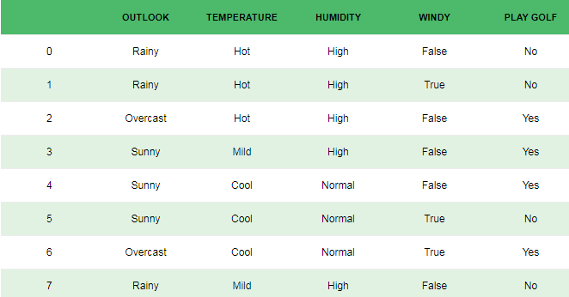
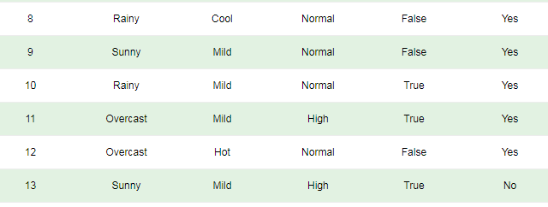
Dataset that describes the weather conditions for playing a game of golf.

Slide 7

Bayes’ Theorem
Bayes’ Theorem finds the probability of an event occurring given the probability of another event that has already occurred.
Bayes’ theorem is stated mathematically as the following equation:
where A and B are events

Slide 8
Bayes’ Theorem
Basically, we are trying to find probability of event A, given the event B is true.
A is called the proposition and B is called the evidence.
P(A) is called the prior probability of proposition and P(B) is called the prior probability of evidence.
P(A|B) is called the posterior probability.
P(B|A) is the likelihood.
This sums the Bayes’ theorem as
Posterior=Likelihood* prior probability/Evidence
P(B) or Evidence is constant for all classes, only P(B|A)* P(B) need be calculated

Slide 9
In other words
Bayes’ Theorem is stated as:
P(class|data) = (P(data|class) * P(class)) / P(data)
Where P(class|data) is the probability of class given the provided data.

Slide 10
In other words
Bayes’ Theorem is stated as:
P(class|data) = (P(data|class) * P(class)) / P(data)
Where P(class|data) is the posterior probability of class given the provided data.
P(data|class) is the likelihood
P(class) is the prior probability

Slide 11
Naive Bayes classifier steps:
Step 1: Calculate the prior probability for given class labels
Step 2: Find Likelihood probability of attribute for each class
Step 3: Put these value in Bayes Formula and calculate posterior probability.
Step 4: Select the class with higher probability .The given input belongs to the higher probability class.

Slide 12
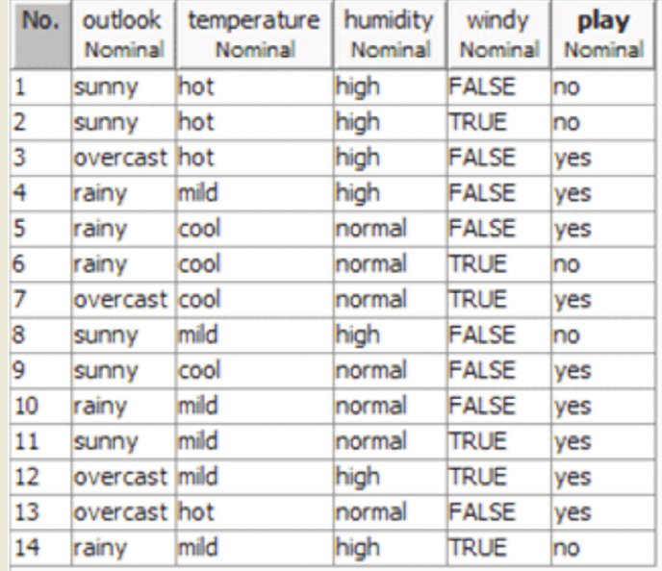
Consider a fictional dataset that describes the weather conditions for playing a game of golf. Given the weather conditions, each tuple classifies the conditions as fit(“Yes”) or unfit(“No”) for plaing golf.

Slide 13
Predict whether the following whether conditions are fit to play golf(yes or no)
Classify the instance
Outlook is sunny
Temperature is cool
Humidity is high
Windy is true
X(outlook=sunny, temperature =cool, humidity=high, windy=true)

Slide 14
Step 1 :Calculation of prior probability of class-P(C)
In the dataset given there are two classes ,yes and no ,so we need to find the probability of yes class and no class
P(play=yes)=9/14
P(play=no)=5/14

Slide 15
Step 2: Find the likelihood probability of each attribute-P(X|C)
Outlook is sunny
ie P(outlook=sunny|play=yes)=2/9
P(outlook=sunny|play=No)=3/5
Yes | No | P(Yes) | P(No)
2 | 3 | 2/9 | 3/5

Slide 16
Step 2: Find the likelihood probability of each attribute-P(X|C)
Temperature is cool
ie P(Temperature = cool |play=yes)=3/9
P(Temperature = cool |play=No)=1/5
Yes | No | P(Yes) | P(No)
3 | 1 | 3/9 | 1/5

Slide 17
Step 2: Find the likelihood probability of each attribute-P(X|C)
Humidity is high
ie P(Humidity = high |play=yes)=3/9
P(Humidity = high |play=No)=4/5
Yes | No | P(Yes) | P(No)
3 | 4 | 3/9 | 4/5

Slide 18
Step 2: Find the likelihood probability of each attribute-P(X|C)
Windy is true
ie P(Windy = true|play=yes)=3/9
P(Windy = true|play=No)=3/5
Yes | No | P(Yes) | P(No)
3 | 3 | 3/9 | 3/5

Slide 19
Step 2: Find the likelihood probability of each attribute-P(X|C)
Probabilities that we can play game
P(outlook=sunny|play=yes)=2/9
P(Temperature = cool |play=yes)=3/9
P(Humidity = high |play=yes)=3/9
P(Windy = true|play=yes)=3/9
Probabilities that we cannot play game
P(outlook=sunny|play=No)=3/5
P(Temperature = cool |play=No)=1/5
P(Humidity = high |play=No)=4/5
P(Windy = true|play=No)=3/5
Test data | Yes | No | P(Yes) | P(No)
Outlook is sunny | 2 | 3 | 2/9 | 3/5
Temperature is cool | 3 | 1 | 3/9 | 1/5
Humidity is high | 3 | 4 | 3/9 | 4/5
Windy is true | 3 | 3 | 3/9 | 3/5

Slide 20
Step 2: Find the overall likelihood probability P(X|C)
P(X|plays=yes) =2/9 * 3/9 * 3/9 *3/9
P(X|plays=no) = 3/5 * 1/5 * 4/5 * 3/5
Where X(outlook=sunny, temperature =cool, humidity=high, windy=true)

Slide 21
Step 3: Calculate the Posterior probability
P(C|X) = P(X|C) *P(C)
P(X|plays=yes) * P(play=yes) = 2/9 * 3/9 * 3/9 *3/9 * 9/14
=0.0053
P(X|plays=no) * P(play=no)= 3/5 * 1/5 * 4/5 * 3/5 * 5/14
= 0.0206

Slide 22
Step 4: Select the class with higher probability
The class P(Play= no) has higher probability .
There fore Naïve Bayes classifier predicts play = no for the given test sample

Slide 23
Naïve Bayes Classifier: example 2
Class:
C1:buys_computer = ‘yes’
C2:buys_computer = ‘no’
Data to be classified:
X = (age <=30,
Income = medium,
Student = yes
Credit_rating = Fair)

Slide 24
Naïve Bayes Classifier: An Example
P(C_{i}): P(buys_computer = “yes”) = 9/14 = 0.643
P(buys_computer = “no”) = 5/14= 0.357
Compute P(X|C_{i}) for each class
P(age = “<=30” | buys_computer = “yes”) = 2/9 = 0.222
P(age = “<= 30” | buys_computer = “no”) = 3/5 = 0.6
P(income = “medium” | buys_computer = “yes”) = 4/9 = 0.444
P(income = “medium” | buys_computer = “no”) = 2/5 = 0.4
P(student = “yes” | buys_computer = “yes) = 6/9 = 0.667
P(student = “yes” | buys_computer = “no”) = 1/5 = 0.2
P(credit_rating = “fair” | buys_computer = “yes”) = 6/9 = 0.667
P(credit_rating = “fair” | buys_computer = “no”) = 2/5 = 0.4
X = (age <= 30 , income = medium, student = yes, credit_rating = fair)
P(X|C_{i}) : P(X|buys_computer = “yes”) = 0.222 x 0.444 x 0.667 x 0.667 = 0.044
P(X|buys_computer = “no”) = 0.6 x 0.4 x 0.2 x 0.4 = 0.019
P(X|C_{i})*P(C_{i}) : P(X|buys_computer = “yes”) * P(buys_computer = “yes”) = 0.028
P(X|buys_computer = “no”) * P(buys_computer = “no”) = 0.007
Therefore, X belongs to class (“buys_computer = yes”)

Slide 25
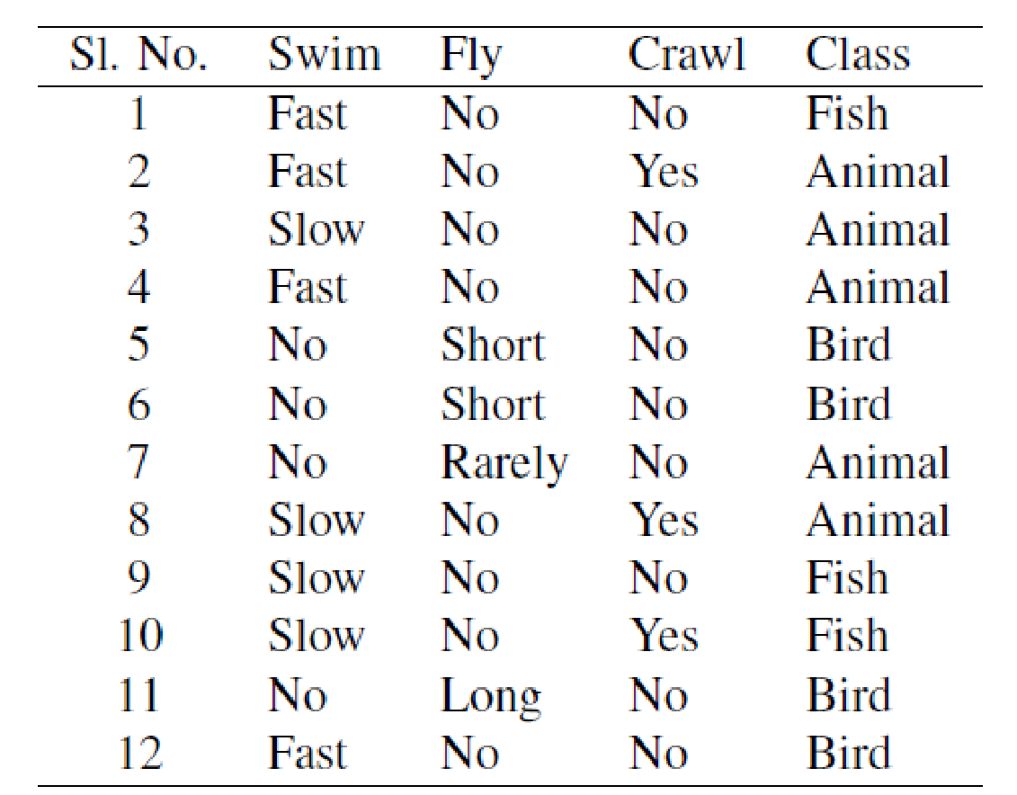
Naïve Bayes Classifier: example 3
X = (swim = slow, Fly = rarely, crawl = No)

Slide 26
Step 1 :Calculation of prior probability of class-P(C)
In the dataset given there are Animal ,bird and fish.so we need to find the probability of Animal ,bird and fish class
P(Animal) = 5/12 = 0.417
P(Bird) = 4/12 = 0.333
P(Fish) = 3/12 = 0.250

Slide 27
Step 2: Find the likelihood probability of each attribute-P(X|C)
P(swim= slow | class= Animal) = 2/5 = 0.4
P(swim= slow | class= Bird) = 0/4 = 0
P(swim= slow | class= Fish) = 2/3 = 0.667
Test data | Animal | Bird | Fish | P(Animal) | P(Bird) | P(Fish)
Swim = Slow | 2 | 0 | 2 | 2/5 | 0/4 | 2/3

Slide 28
Step 2: Find the likelihood probability of each attribute-P(X|C)
Probabilities that it is an Animal
P(swim= slow | class= Animal) = 2/5 = 0.4
P(fly= rarely | class= Animal) = 1/5 = 0.2
P(crawl= no | class= Animal) = 3/5 = 0.6
Probabilities that it is a bird
P(swim= slow | class= Bird) = 0/4 = 0
P(fly= rarely | class= Bird) = 0/4 = 0
P(crawl= no | class= Bird) = 4/4 = 1
Probabilities that it is a fish
P(swim= slow | class= Fish) = 2/3 = 0.667
P(fly= rarely | class= Fish) = 0/3 = 0
P(crawl= no | class= Fish) = 2/3 = 1
Test data | A | B | F | P(A) | P(B) | P(F)
Swim = Slow | 2 | 0 | 2 | 2/5 | 0/4 | 2/3
Fly = rarely | 1 | 0 | 0 | 1/5 | 0/4 | 0/3
Crawl= NO | 3 | 4 | 2 | 3/5 | 4/4 | 2/3

Slide 29
Step 2: Find the overall likelihood probability P(X|C)
P(X|class=Animal) = 0.4 x 0.2 x 0.6
P(X|class= bird) = 0 x 0 x 1
P(X|class= fish) = 0.667 x 0 x 1
Where X = (swim = slow, Fly = rarely, crawl = No)

Slide 30
Step 3: Calculate the Posterior probability
P(C|X) = P(X|C) *P(C)
P(X|class=Animal) = 0.4 x 0.2 x 0.6 x 0.417 =0.020
P(X|class= bird) = 0 x 0 x 1 x 0.333 = 0
P(X|class= fish) = 0.667 x 0 x 1 x 0.250= 0
Where X = (swim = slow, Fly = rarely, crawl = No)

Slide 31
Step 4: Select the class with higher probability
The class Animal has higher posterier probability .
So we assign the class label “Animal” to the test instance
X = (swim = slow, Fly = rarely, crawl = No)

